Slide 1
Cloud Computing
SEWP ZG527

Slide 2



Hadoop
Name of the elephant!!
Notes:
RL 8.1

Slide 3
Hadoop common Component
MapReduce – offline computing engine (Data Processing Framework)
HDFS – Hadoop Distributed file system (Data Storage Framework
Frameworks like Hbase, Pig and Hive have been built on top of Hadoop.
Pig is a dataflow language and execution environment over Hadoop.
Hbase is a distributed key-value store which supports SQL-like queries similar to Google’s BigTable
Hive is a distributed data warehouse to manage data stored in the Hadoop File System.
Notes:
RL 8.2

Slide 4
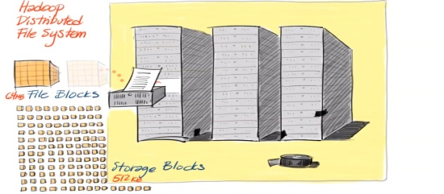
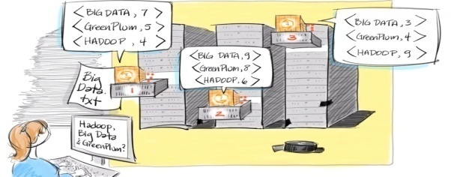
MapReduce (Data Processing Framework)
MapReduce
Software Framework for easily running applications
Processes large amount of data in parallel
Using large clusters having thousands of nodes
Nodes of commodity hardware
In a reliable and fault-tolerant manner

Slide 5
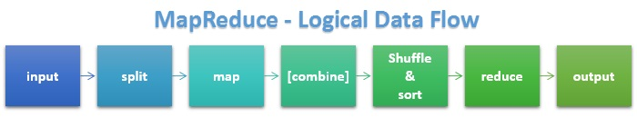
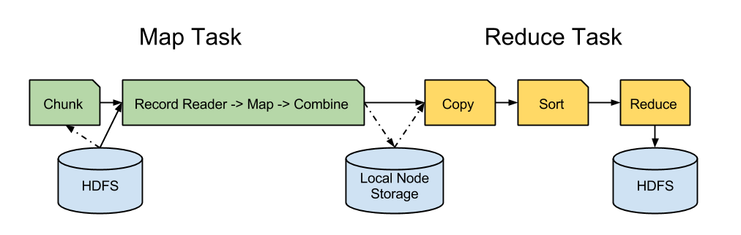
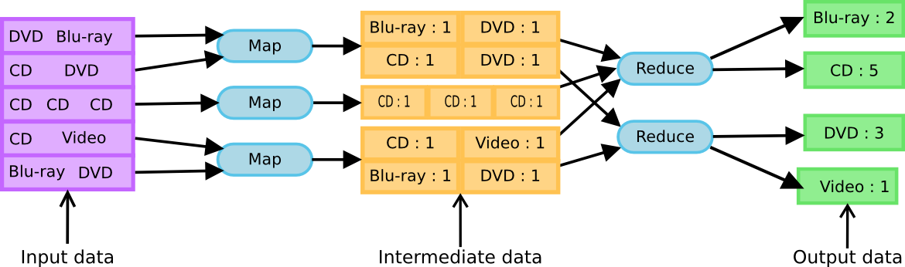
MapReduce Processing flow
Logical flow:
Two phases
Example:

Slide 6
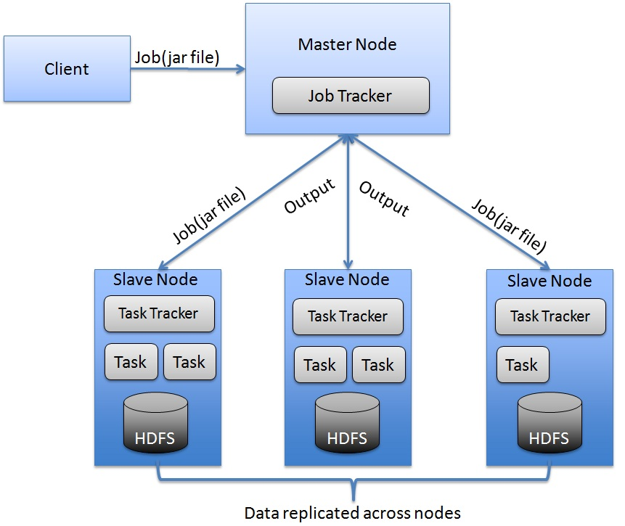
Architecture Overview
blog.raremile.com

Slide 7
Architecture (cont.)
NameNode/ Master Node:
Stores metadata for the files, like the directory structure of a typical FS.
The server holding the NameNode instance is quite crucial, as there is only one.
Transaction log for file deletes/adds, etc.
Handles creation of more replica blocks when necessary after a DataNode failure
It is a single master server exist in the HDFS cluster.
As it is a single node, it may become the reason of single point failure.
It manages the file system namespace by executing an operation like the opening, renaming and closing the files.
It simplifies the architecture of the system.

Slide 8
Datanode
Stores the actual data in HDFS
Can run on any underlying filesystem (ext3/4, NTFS, etc)
Notifies NameNode of what blocks it has
NameNode replicates blocks 2x in local rack, 1x elsewhere
The HDFS cluster contains multiple DataNodes.
Each DataNode contains multiple data blocks.
These data blocks are used to store data.
It is the responsibility of DataNode to read and write requests from the file system's clients.
It performs block creation, deletion, and replication upon instruction from the NameNode.

Slide 9
Job Tracker
The role of Job Tracker is to accept the MapReduce jobs from client and process the data by using NameNode.
In response, NameNode provides metadata to Job Tracker.
Task Tracker
It works as a slave node for Job Tracker.
It receives task and code from Job Tracker and applies that code on the file. This process can also be called as a Mapper.

Slide 10
Architecture (cont.)
The Job Tracker:
Central authority for the complete MapReduce cluster and responsible for scheduling and monitoring MapReduce jobs
Responds to client request for job submission and status
The Task Tracker:
Workers that accepts map and reduce tasks from job tracker, launches them and keeps track of their progress, reports the same to job tracker.
Keeps track of resource usage of tasks and kills the tasks that overshoots their memory limits

Slide 11
Advantages of Hadoop
Fast: In HDFS the data distributed over the cluster and are mapped which helps in faster retrieval. Even the tools to process the data are often on the same servers, thus reducing the processing time. It is able to process terabytes of data in minutes and Peta bytes in hours.
Scalable: Hadoop cluster can be extended by just adding nodes in the cluster.
Cost Effective: Hadoop is open source and uses commodity hardware to store data so it really cost effective as compared to traditional relational database management system.
Resilient to failure: HDFS has the property with which it can replicate data over the network, so if one node is down or some other network failure happens, then Hadoop takes the other copy of data and use it. Normally, data are replicated thrice but the replication factor is configurable.

Slide 12
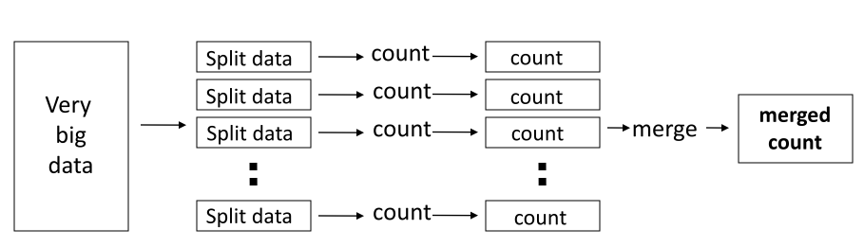
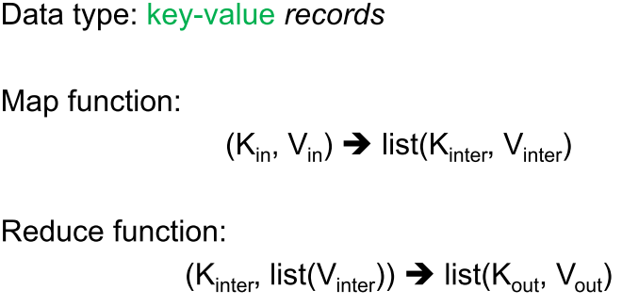
Distributed Word Count
MapReduce Programming Model

Slide 13
Example: Word Count
def mapper(line):
foreach word in line.split():
output(word, 1)
def reducer(key, values):
output(key, sum(values))

Slide 14
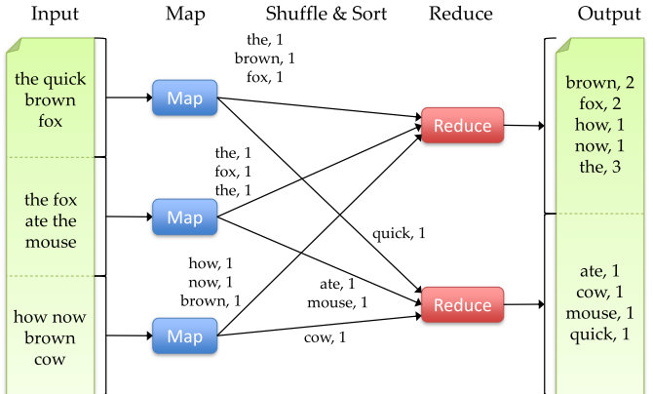
Word Count Execution

Slide 15
An Optimization: The Combiner
Local reduce function for repeated keys produced by same map
Decreases amount of intermediate data
• Example: local counting for Word Count:
An Optimization: The Combiner
def combiner(key, values):
output(key, sum(values))

Slide 16
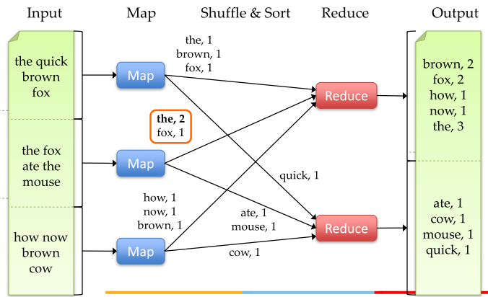
Word Count with Combiner

Slide 17
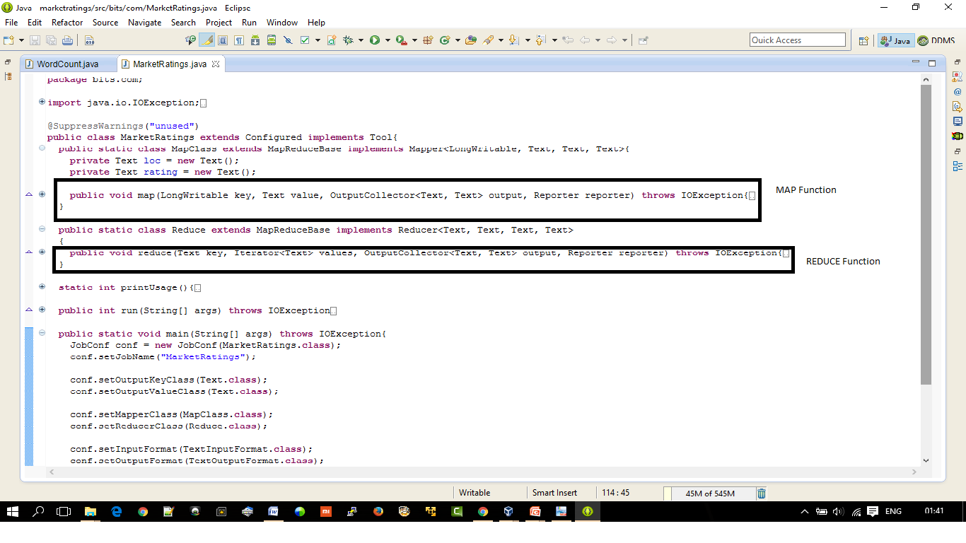
Snapshot of MarketRatings example and Program demo

Slide 18
MapReduce Execution Details
Mappers preferentially scheduled on same node or same
rack as their input block
– Minimize network use to improve performance
Mappers save outputs to local disk before serving to
reducers
– Allows recovery if a reducer crashes
– Allows running more reducers than # of nodes

Slide 19
Fault Tolerance in MapReduce
1. If a task crashes:
– Retry on another node
• OK for a map because it had no dependencies
• OK for reduce because map outputs are on disk
– If the same task repeatedly fails, fail the job or ignore that input block
2. If a node crashes:
– Relaunch its current tasks on other nodes
– Relaunch any maps the node previously ran
• Necessary because their output files were lost along
with the crashed node

Slide 20
Fault Tolerance in MapReduce
3. If a task is going slowly (straggler):
– Launch second copy of task on another node
– Take the output of whichever copy finishes first, and kill the other one
• Critical for performance in large clusters

Slide 21
Challenges of Cloud Environment
Cheap nodes fail, especially when you have many
– Mean time between failures for 1 node = 3 years
– MTBF for 1000 nodes = 1 day
– Solution: Build fault tolerance into system
Commodity network = low bandwidth
– Solution: Push computation to the data
Programming distributed systems is hard
– Solution: Restricted programming model: users write
data-parallel “map” and “reduce” functions and system
handles work distribution and failures

Slide 22
Hadoop
Thanks Hadoop

